Slide 1


Writing blog posts:
How to give visibility to
your content?
Carolina Lessa C. de Souza,
Head of UNEP Internal Communication

Slide 2

  Writing is for everyone!
  Are you not a communications specialist or a native English speaker? You can still write well-crafted blog posts.
  Writing is an exercise. The more you do, the better you become.
  Trust in your potential.

Slide 3

2. Blog post structure
  Hierarchize information >>
more relevant to less important
  First paragraph >>
your most important piece
  WHAT? WHEN? WHERE? WHO? WHY?

Slide 4
2. Blog post structure
To mark 2024 World Environment Day, the Center for International Forestry Research and World Agroforestry (CIFOR-ICRAF) brought their lab to the UN complex in Nairobi (UNON) to teach students the basics of soil management and opportunities for restoration.

Slide 5
2. Blog post structure
What?
To mark 2024 World Environment Day, the Center for International Forestry Research and World Agroforestry (CIFOR-ICRAF) brought their lab to the UN complex in Nairobi (UNON) to teach students the basics of soil management and opportunities for restoration.
When?
Who?
Where?
Why?

Slide 6

2. Blog post structure
  Additional information
    Up to 350 characters
    Create a catchy subtitle
    Don’t use acronyms on the title
    In the text, only use acronyms after spelling it out
    Advisable: Add quotes/ short sentences and paragraphs

Slide 7
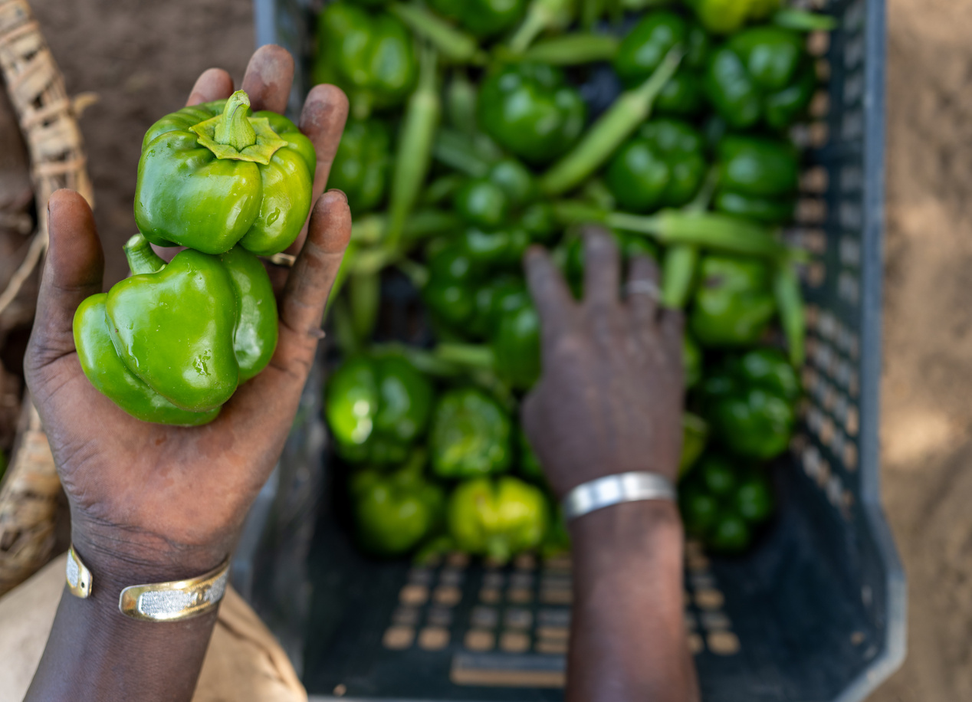
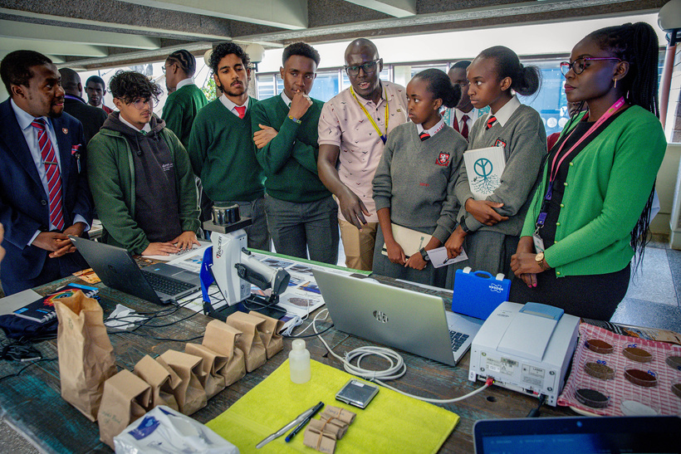
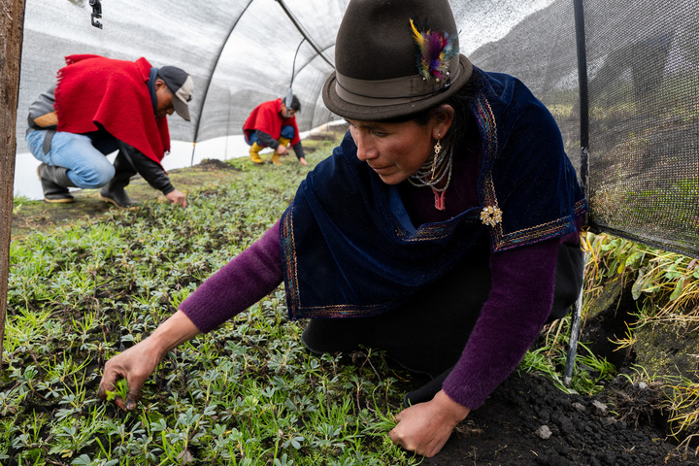
3. Final touch: Pictures
Which picture better describes the article?
1.
2.
3.

Slide 8

3. Final touch: Pictures
  Images say more than 1000 words
  Opt for UNEP-owned pictures taken by your office or the UNEP Multimedia team
  Where to find them? UNEP Flicker and UNEP Digital Library.
  Others: UN Photo, Grid-Arendal, Unsplash, Pixabay and Pexels - copyright-free

Slide 9
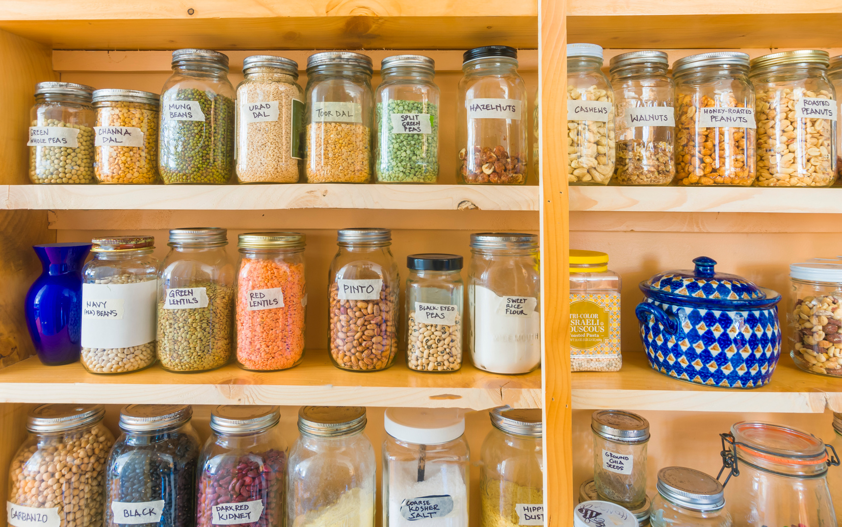
4. Posting your blog post in the right place
  Write blogs choosing applicable division/office (not from personal space)
  Use appropriate tags:
hq_news for HQ News section
no tag for the Regional News section
  Guide through on weCollaborate >>

Slide 10
THANK YOU!

